Slide 1
From Zero to Hero – Learning R by Examples

Slide 2
Prerequisites
Being prepare to start your R journey

Slide 3
Installing R and R Studio
R is a statistics programming language, R Studio is an IDE for R that helps you code faster and neater.
Before installing Rstudio, make sure to have R installed first.
Downloading R from one of the mirror and follow the instructions, eg. https://cloud.r-project.org/
Download and install Rstudio: https://www.rstudio.com/products/rstudio/download2/
Resources:
Official site of R: https://www.r-project.org/
Official site of Rstudio: https://www.rstudio.com/
UCLA starter kit: http://www.ats.ucla.edu/stat/r/sk/
Quick R: http://www.statmethods.net/
R blogger: https://www.r-bloggers.com/how-to-learn-r-2/

Slide 4


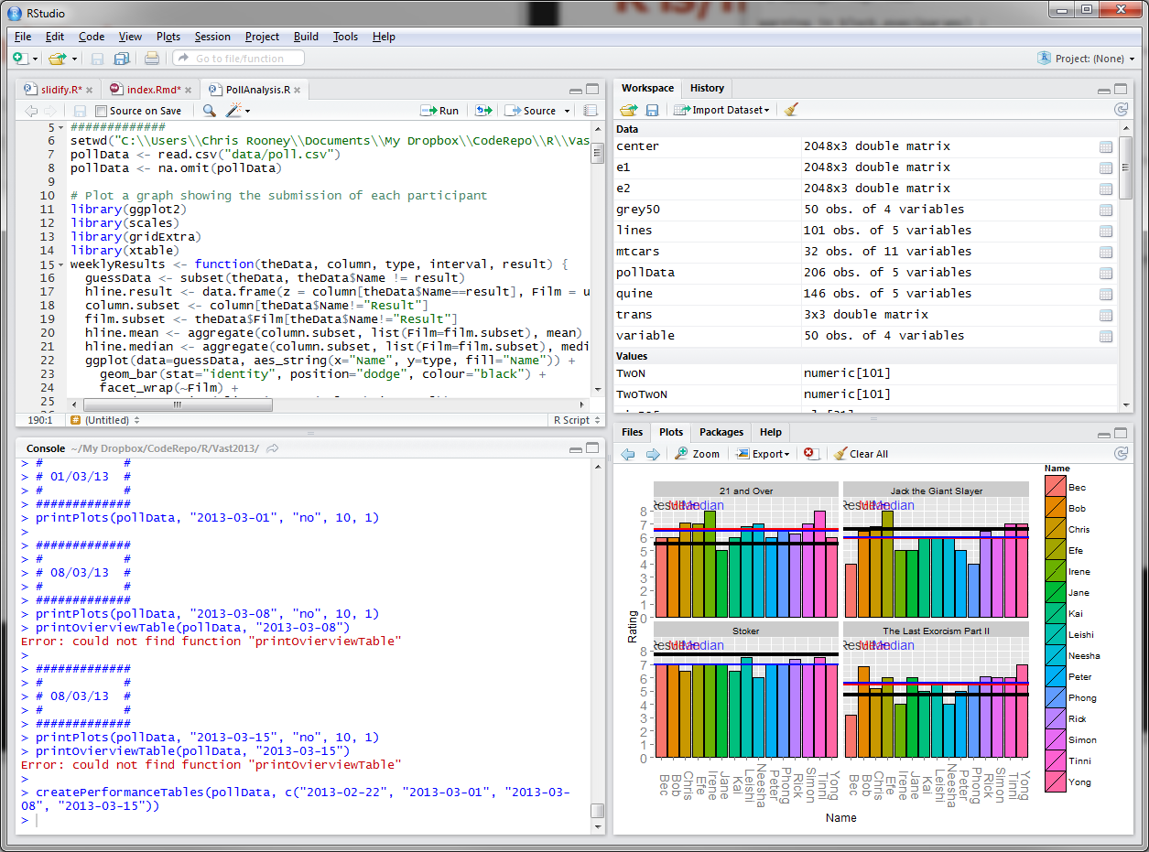
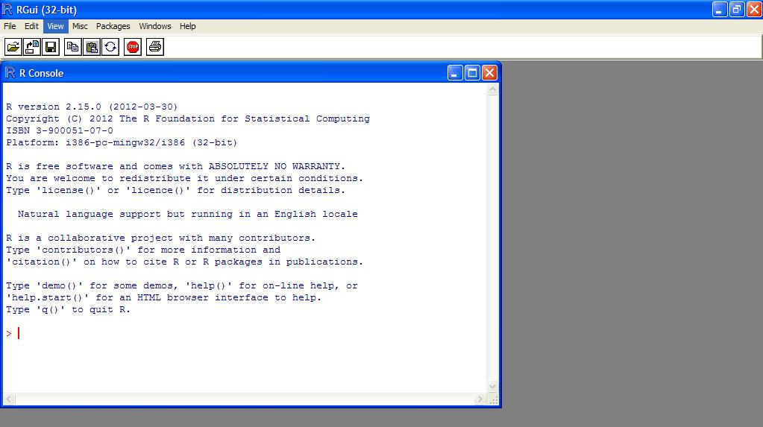
Make sure you are on the right page
After installing R Studio, you should see this interface:
After installing R before installing R Studio, you should see this interface after clicking the R icon

Slide 5
Basic Arithmetic and Data types
Go through intro: http://www.r-tutor.com/r-introduction
Basic data types: http://www.r-tutor.com/r-introduction/basic-data-types
Vectors: http://www.r-tutor.com/r-introduction/vector
Matrix: http://www.r-tutor.com/r-introduction/matrix
List: http://www.r-tutor.com/r-introduction/list
Data Frame: http://www.r-tutor.com/r-introduction/data-frame

Slide 6
Titanic: Machine Learning from Disaster
From https://www.kaggle.com/c/titanic , by kaggle user: Megan Risdal

Slide 7
Preparations
Load packages
Read in data

Slide 8
Load packages
# install packages
install.packages("ggplot2")
install.packages("dplyr")
install.packages("mice")
install.packages("randomForest")
# Load packages
library('ggplot2') # visualization
library('dplyr') # data manipulation
library("mice") # imputation
library('randomForest') # classification algorithm

Slide 9
Read in data
Variable Name | Description
Survived | Survived (1) or died (0)
Pclass | Passenger’s class
Name | Passenger’s name
Sex | Passenger’s sex
Age | Passenger’s age
SibSp | Number of siblings/spouses aboard
Parch | Number of parents/children aboard
Ticket | Ticket number
Fare | Fare
Cabin | Cabin
Embarked | Port of embarkation
# set working directory
setwd("~/PPTs/data analytics")
train <- read.csv('train.csv')
test <- read.csv('test.csv')
full <- bind_rows(train, test)

Slide 10
Exploratory analysis
Survival by class/gender
Do family sink together?

Slide 11
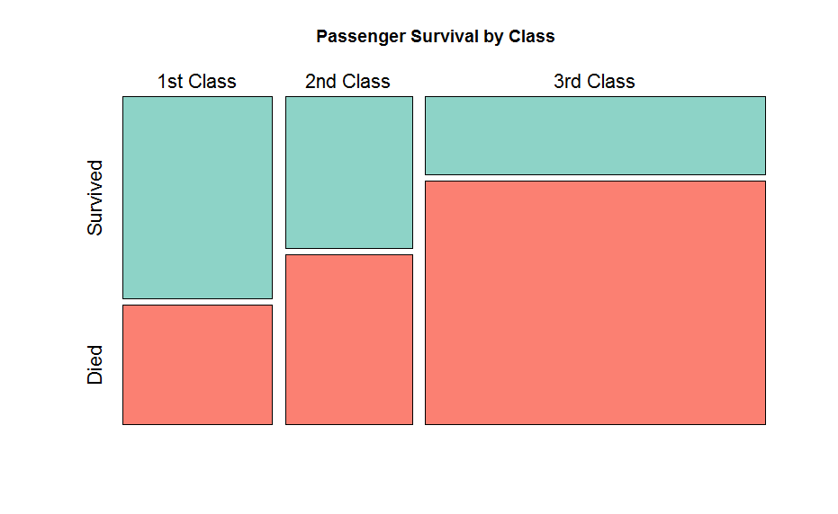
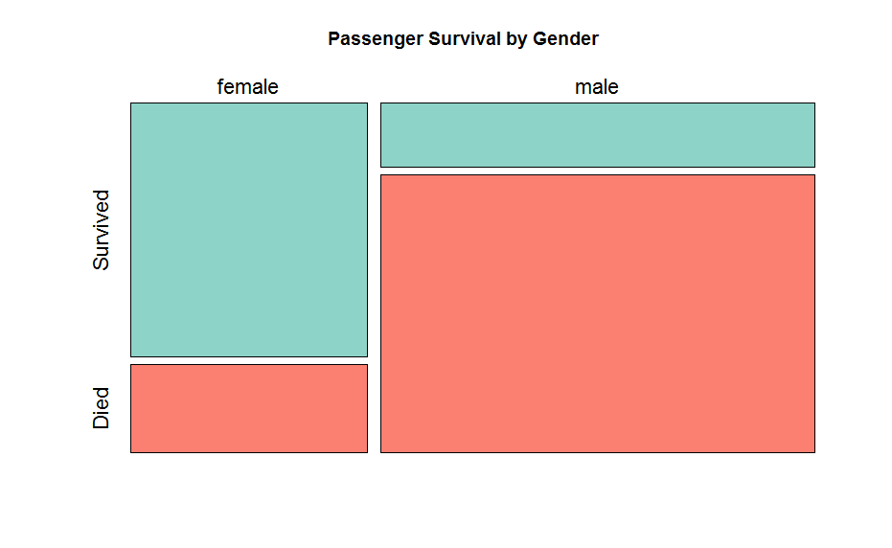
Survival by Class/Gender
# exploratory analysis
# transfer from integer to factor
full$Survived <- factor(full$Survived, levels=c(1,0))
levels(full$Survived) <- c("Survived", "Died")
full$Pclass <- as.factor(full$Pclass)
levels(full$Pclass) <- c("1st Class", "2nd Class", "3rd Class")
mosaicplot(full[1:891,]$Pclass ~ full[1:891,]$Survived, # specify the x-axis and y-axis
main="Passenger Survival by Class", # give your ploat a title
color=c("#8dd3c7", "#fb8072"), # specify color
shade=FALSE, xlab="", ylab="", # specify x/y axis labels
cex.axis=1.4) # specify font size
dev.off() # close the plot
mosaicplot(full[1:891,]$Sex ~ full[1:891,]$Survived,
main="Passenger Survival by Gender",
color=c("#8dd3c7", "#fb8072"),
shade=FALSE, xlab="", ylab="",
cex.axis=1.4)
dev.off()

Slide 12
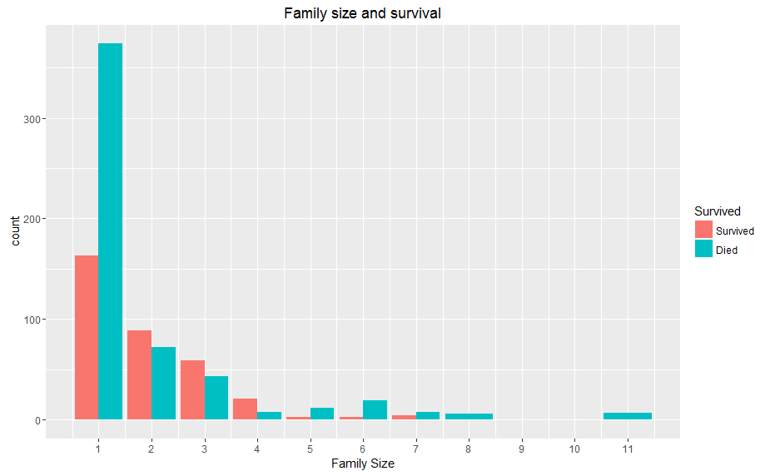
Do families sink together?
# Does family sink together?
# 1. get surname: 875 unique surname out of 1309 people
full$Surname <- sapply(as.character(full$Name),
function(x) strsplit(x, split = '[,.]')[[1]][1])
nlevels(factor(full$Surname))
# 2. create a variable of family size:
# Create a family size variable including the passenger themselves
full$Fsize <- full$SibSp + full$Parch + 1
# Create a family variable
full$Family <- paste(full$Surname, full$Fsize, sep='_')
# 3. plot histogram based on family size
ggplot(full[1:891,], aes(x = Fsize, fill = Survived)) +
geom_bar(stat='count', position='dodge') +
scale_x_continuous(breaks=c(1:11)) +
labs(x = 'Family Size') +
ggtitle("Family size and survival")
# for singleton and family size > 4, they have a survival penalty
# Discretize family size
full$FsizeD[full$Fsize == 1] <- 'singleton'
full$FsizeD[full$Fsize < 5 & full$Fsize > 1] <- 'small'
full$FsizeD[full$Fsize > 4] <- 'large'

Slide 13
Treating missing values
Predictive imputation

Slide 14
# missing values
# age is missing
sum(is.na(full$Age))
# Make variables factors into factors
factor_vars <- c('PassengerId','Pclass','Sex',
'Surname','Family','FsizeD')
full[factor_vars] <- lapply(full[factor_vars], function(x) as.factor(x))
# Set a random seed
set.seed(129)
# Perform mice imputation, excluding certain less-than-useful variables:
mice_mod <- mice(full[, !names(full) %in% c('PassengerId','Name','Ticket','Cabin','Family','Surname','Survived')], method='rf')
mice_output <- complete(mice_mod)
# Replace Age variable from the mice model.
full$Age <- mice_output$Age
# Show new number of missing Age values
sum(is.na(full$Age))

Slide 15
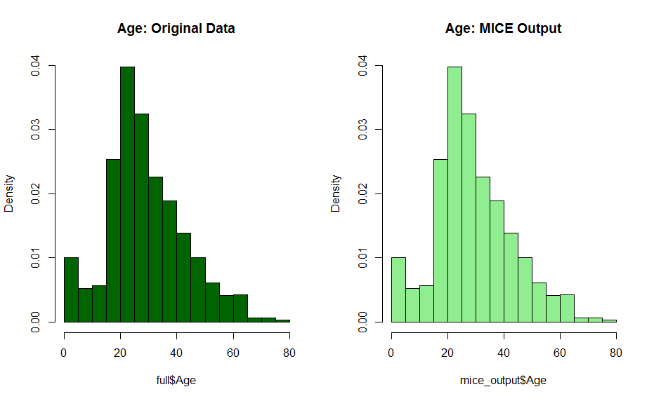
Comparing age histogram-before and after
# Plot age distributions, now let's compare before and after
par(mfrow=c(1,2))
hist(full$Age, freq=F, main='Age: Original Data',
col='darkgreen', ylim=c(0,0.04))
hist(mice_output$Age, freq=F, main='Age: MICE Output',
col='lightgreen', ylim=c(0,0.04))
dev.off()

Slide 16
Prediction
Random forest model

Slide 17
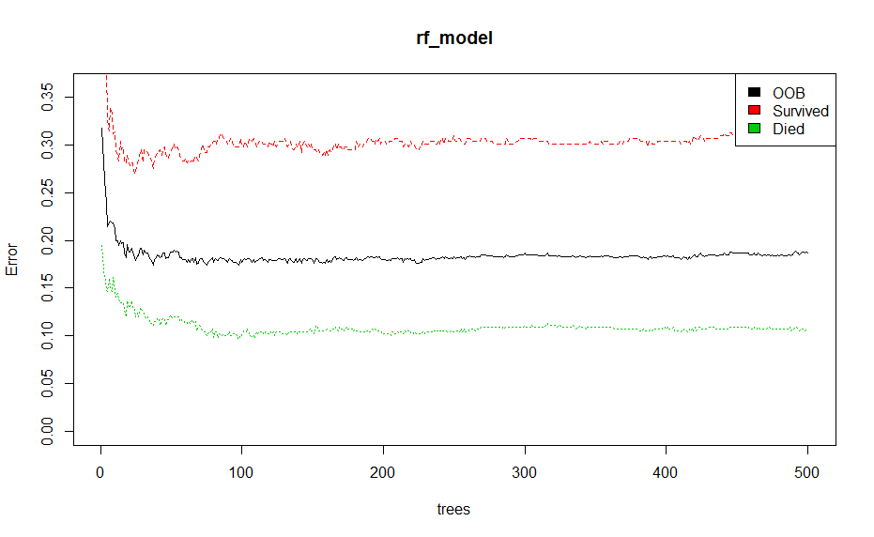
Random forest model
# prediction
# Split the data back into a train set and a test set
train <- full[1:891,]
test <- full[892:1309,]
# Set a random seed
set.seed(754)
# Build the model (note: not all possible variables are used)
rf_model <- randomForest(factor(Survived) ~ Pclass + Sex + Age + SibSp + Parch + Fare + FsizeD ,
data = train)
# Show model error
plot(rf_model, ylim=c(0,0.36))
legend('topright', colnames(rf_model$err.rate), col=1:3, fill=1:3)

Slide 18
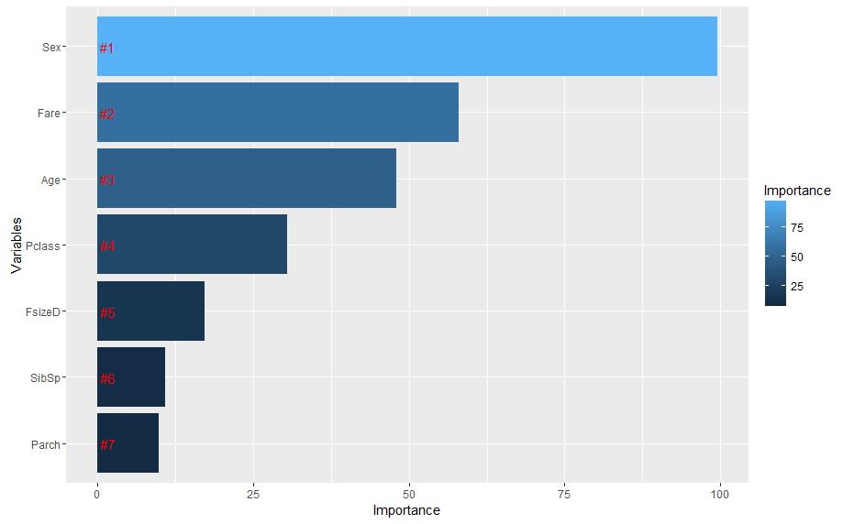
Variable importance in random forest model
ggplot(rankImportance, aes(x = reorder(Variables, Importance),
y = Importance, fill = Importance)) +
geom_bar(stat='identity') +
geom_text(aes(x = Variables, y = 0.5, label = Rank),
hjust=0, vjust=0.55, size = 4, colour = 'red') +
labs(x = 'Variables') +
coord_flip()

Slide 19
Q & A

